Slide 1
AI Visual Odometry
Group 9: Arnas, Frej, Tommi
Notes:
Arnas

Slide 2
Visual odometry
Getting own movement only using cameras
Usually done with computationally expensive machine vision algorithms
Requires expensive hardware
Notes:
Arnas

Slide 3
AI visual odometry
Cheaper hardware for smaller model
Notes:
Tommi

Slide 4
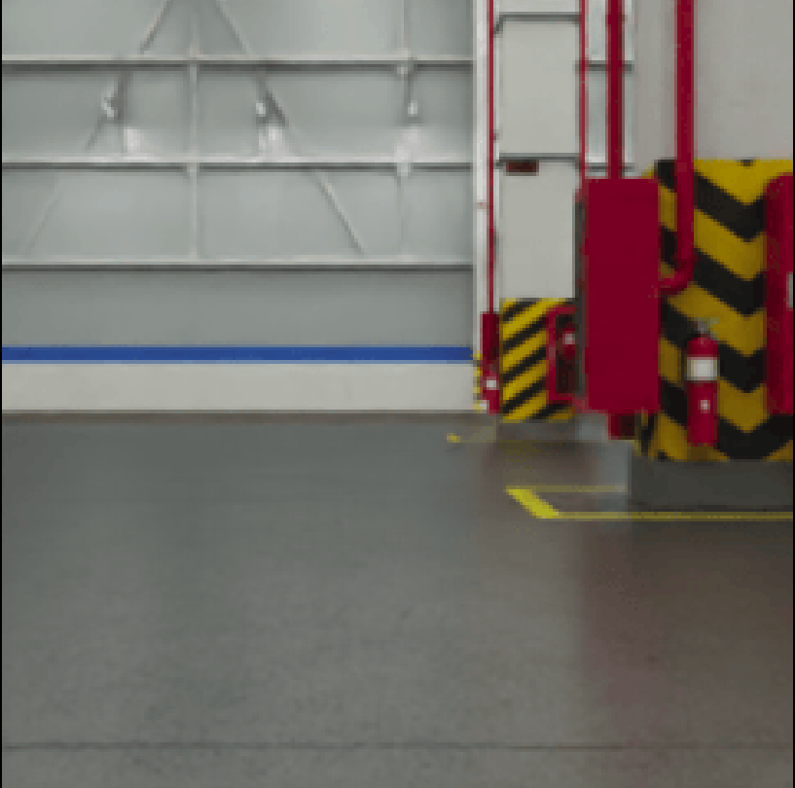
Data generation
Nvidia ISAAC sim
Camera parameters
3D warehouse
Notes:
Tommi

Slide 5
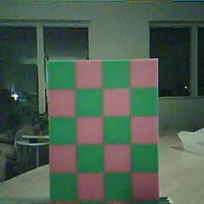
Camera parameter estimations
Estimating focal length
Each square is 20mm
Each square is 32 pixels
Pixel scale is 1200/240 = 5
Each square scaled = 160 pixels
Distance is 200mm
Pixel size of sensor is 2.2µm
Focal length(pixels) = square(pixels)*distance(mm)/square(mm)
Focal length(mm) = focal length(pixels)*pixel size(mm)
Focal length(mm) = 3.52mm
Notes:
Arnas

Slide 6
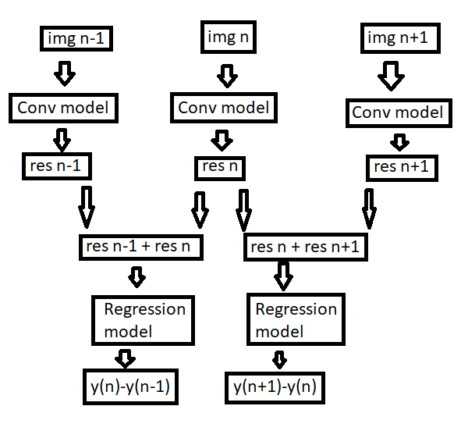
Model structure
Notes:
Tommi

Slide 7
Model creation
ResNet-50
Good results but very big
Custom CNN trained on custom dataset
Good results and small size
Notes:
Tommi

Slide 8
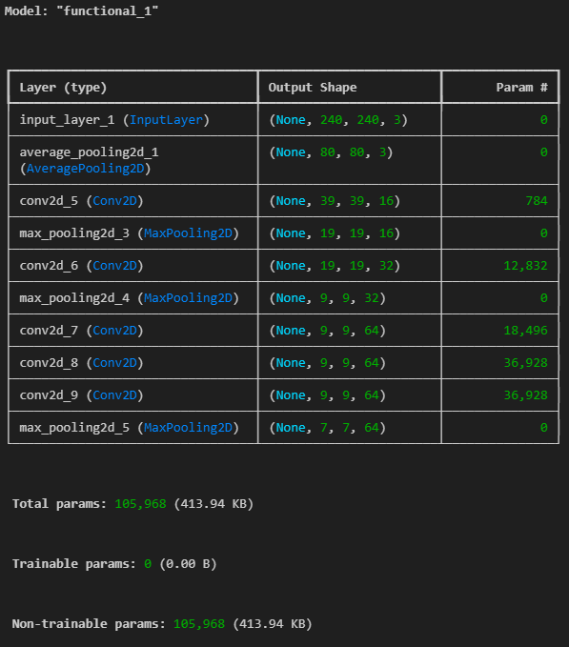
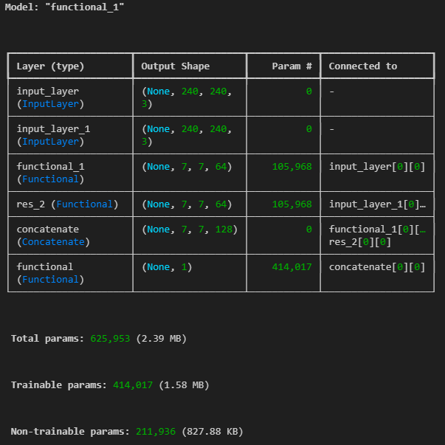
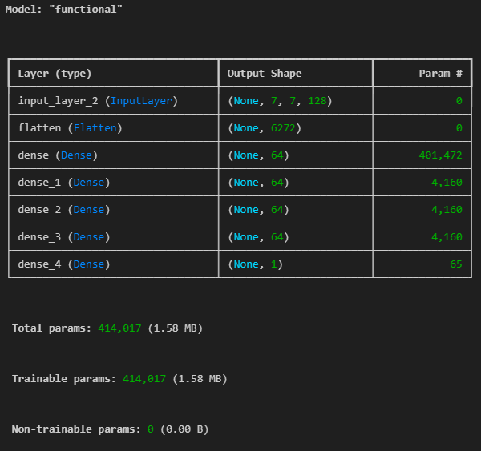
Tf models
Notes:
Tommi

Slide 9
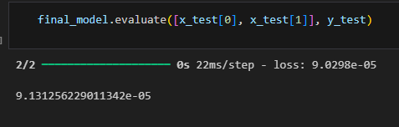
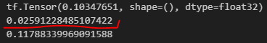
PC results
Low avg loss (less than 0.0001m)
execution time around 20-30ms
Notes:
Tommi

Slide 10
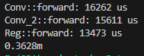
ESP_32 results/demo
Total time around 30ms
Not enough space for 2 img in ram
Notes:
Tommi

Slide 11
Interference on FPGA
Goal move pretrained model to fpga
Notes:
Frej

Slide 12
Challenges
PS FPGA communication
Constrained environment = lack of predefined software
Is it possible to implement the interference on FPGA and send weights
Notes:
Frej

Slide 13
Approach
Download model weights from tensorflow
Build model with weigts in cpp
Validate model from json data
Migrate of model to run on FPGA
Notes:
Frej

Slide 14
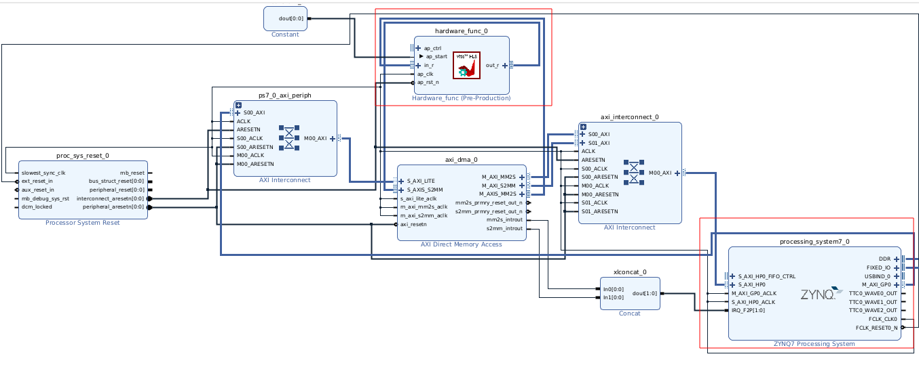
Notes:
Frej

Slide 15
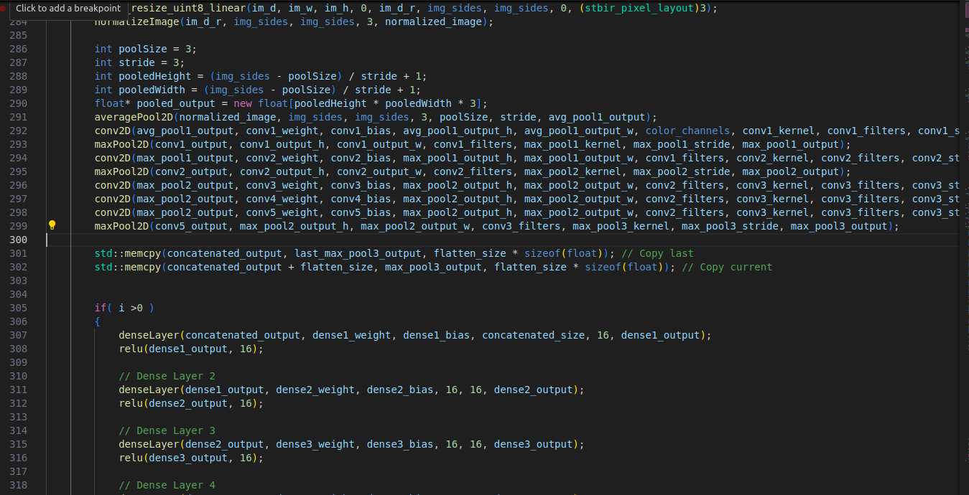
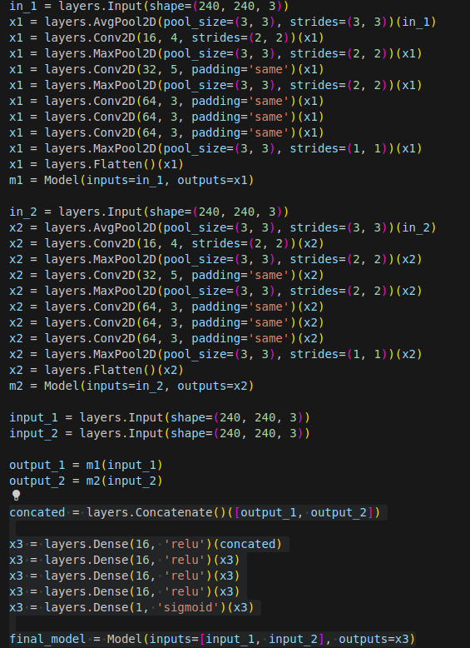
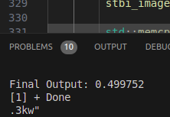
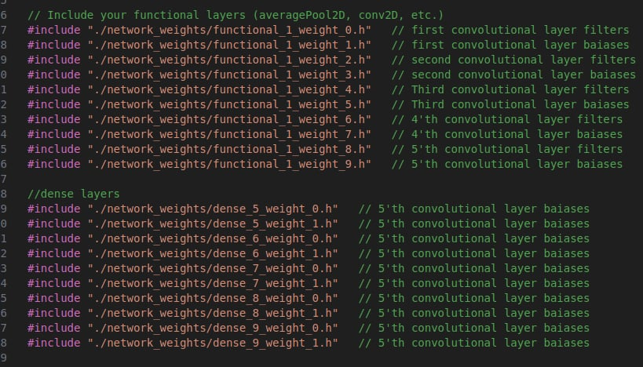
Notes:
Frej

Slide 16
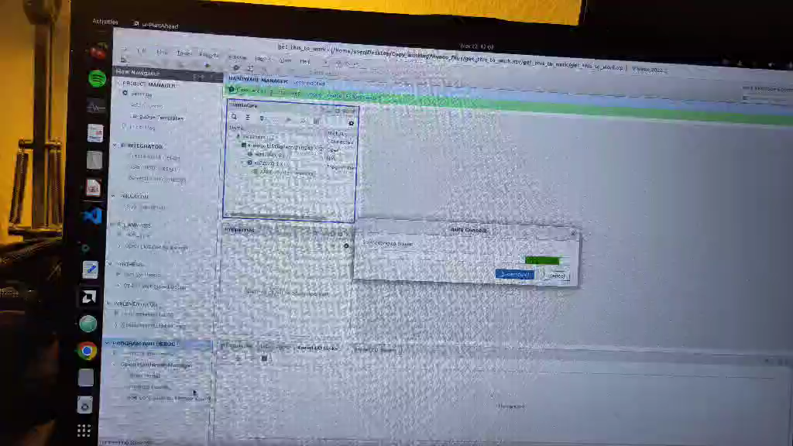

Slide 17
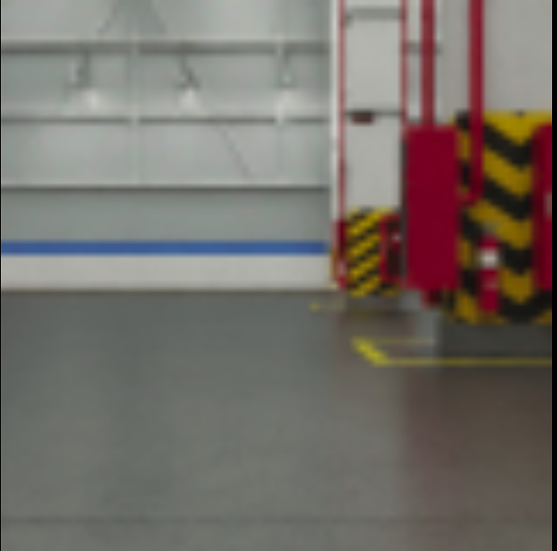
Notes:
Frej

Slide 18

Future work
Finish Dataset with correct camera parameters
Expand to x and rotation as well
When full model is available integrate fully on ESP
Integrate fully on FPGA
Notes:
Arnas

